Slide 1
SAT Prep Warm-ups
Week 8

Slide 2
Monday
L.T. I can use precise language, domain-specific vocab & techniques

Slide 3
Fewer vs. Less
Fewer: used when referring to countable objects & concepts
Ex: Diana’s yard has fewer squirrels than mine.
My sister has fewer dollars than I do.
Less: used ONLY with a grammatically SINGULAR noun
Ex: Diana’s yard has less wildlife than mine.
I have less money than my sister.
*Common misuse of less is a sign you probably encounter freqently at the grocery store: The 10 items or less sign should actually be 10 items or fewer, because the items are countable.

Slide 4
Many vs. Much
Many: modifies things that can be counted (plural nouns)
Ex: Samantha has many awards in her collection.
Johnny has many dollars in his piggy bank.
Much: modifies things that cannot be counted, often SINGULAR nouns
Ex: Jim has much more money than I do.

Slide 5
Tuesday
L.T. I can determine area when pieces are removed from a shape

Slide 6
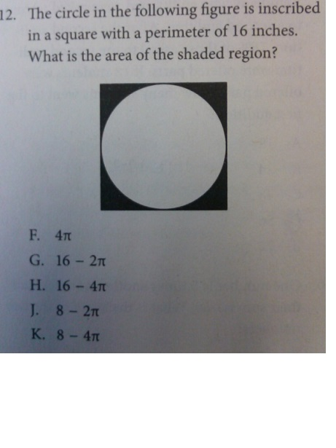

Slide 8
Wednesday
L.T. I can revise writing using appropriate punctuation

Slide 9
Fix the following sentence...
Pet iguanas like to sit in high places however it is still a surprise when one jumps onto your head.

Slide 10
Pet iguanas like to sit in high places; however, it is still a surprise when one jumps onto your head.

Slide 11
Thursday
L.T. I can use my understanding of geometry to solve problems

Slide 12
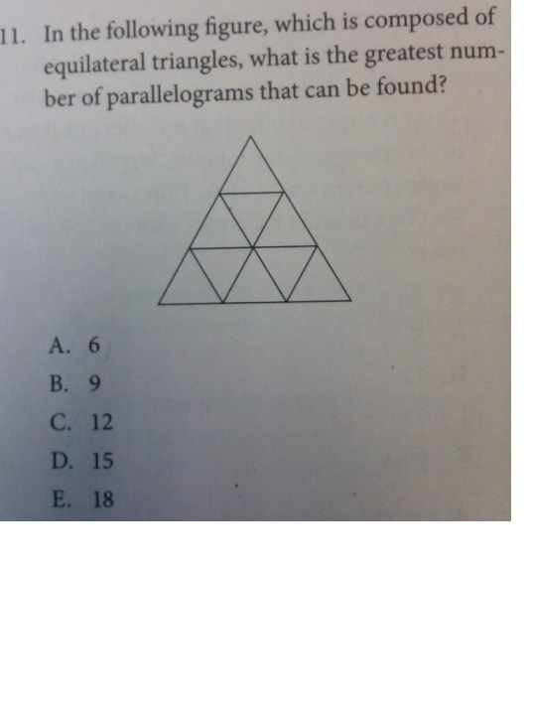

Slide 14
L.T. I can determine the probability of an event occurring

Slide 15
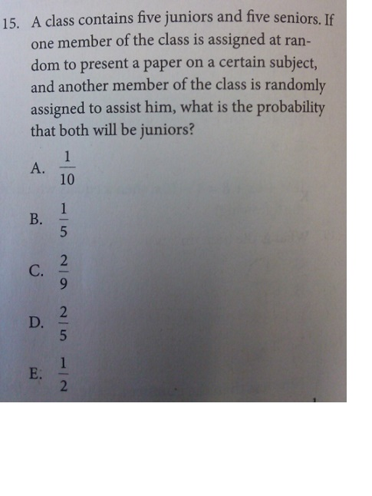

Slide 17
Friday
L.T.

Slide 18
Quickwrite: Please write for the next 15 minutes on the following prompt
Who is your real-life hero?
It should be someone who you admire for either their ability to overcome adversity, or inspire others to be better individuals. It could be a family member, a former teacher, a co-worker, etc., but should NOT be an actor or comic book character!

