Slide 1
SAT Warm Ups
Week 2

Slide 2
Monday
L.T. I can use precise language, domain-specific vocab & techniques

Slide 3
Afflict vs. Inflict pg 539
Afflict: to torment or distress someone or something. Usually used as a passive verb.
Ex: Jeff is afflicted with frequent migraine headaches.
Inflict: to impose punishment or suffering on someone or something.
Ex: No one dared displease the king, for he was known to inflict severe punishments on those who upset him.

Slide 4
Allusion vs Illusion pg 539
Allusion: an indirect reference to something; a hint *The Bible is the most frequently alluded piece of literature!
Ex: The teacher’s comment about the most enigmatic smile in art history was not lost on Sopie; this allusion could only be a reference to Leonardo da Vinci’s Mona Lisa.
Illusion: a false, misleading, or deceptive appearance
Ex: A magician creates the illusion that something has disappeared by hiding it faster than the eye can follow it.

Slide 5
Tuesday
L.T. I can identify a linear equation when provided a graph

Slide 6
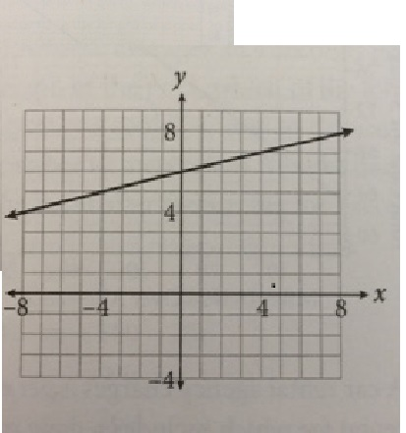
Linear Equations 110 pts
Which of the following equations represents the line shown in the graph?
y=6x+¼
y= ^{x}/₄ +6
y=4x +6
y= 6x + 4

Slide 7
Linear Equations 110 pts
Which of the following equations represents the line shown in the graph?
y=6x+¼
y= ^{x}/₄ +6
y=4x +6
y= 6x + 4

Slide 8
Reasoning
POE!!
Since answers are written in slope-intercept form (y=mx+b), find the slope of the line and its y-intercept and match to answer options.
The line crosses the vertical axis at (0,6), making the y-intercept of the line 6
(this eliminates answers A & D)
To find the slope of the line, you can count the rise & run (RISE OVER RUN) from the y-intercept to the next point that lands on the intersection of two grid-lines or use the slope formula.

Slide 9
Wednesday
LT: I can maintain a formal style and objective tone while attending to the norms and conventions of the writing provided.

Slide 10
Language practice
Since primitive times, societies have created, and told legends. Even before the development of written language, cultures would orally pass down these popular stories.
NO CHANGE
Created then subsequently told
Created and told
Created, and told original

Slide 11
Language practice
Since primitive times, societies have created, and told legends. Even before the development of written language, cultures would orally pass down these popular stories.
NO CHANGE
Created then subsequently told
Created and told
Created, and told original

Slide 12
Thursday
L.T. I can determine percentage of change (with OR without a calculator!)

Slide 13
Rates, Ratios, Proportions & % 80 total pts
An architect is working on a design for a solar power plant. While double-checking the blueprint, he realizes that he has made an error: The solar panels will not fit on the roof unless the dimensions of the roof are increased by 0.5%. Which of the following expresses this change in the dimensions of the roof as a fraction of the original dimensions?
1/2000
1/200
1/20
1/2

Slide 14
Rates, Ratios, Proportions & % 80 total pts
An architect is working on a design for a solar power plant. While double-checking the blueprint, he realizes that he has made an error: The solar panels will not fit on the roof unless the dimensions of the roof are increased by 0.5%. Which of the following expresses this change in the dimensions of the roof as a fraction of the original dimensions?
1/2000
1/200
1/20
1/2

Slide 15
Reasoning
Don’t get overwhelmed by wordy problems!
This question is simply asking you to convert 0.5% to a fraction.
Remember that “percent” means per hundred. This means divide by 100!
Therefore, 0.5%= 0.5 divided by 100: ½ X 1/100 = 1/200.

Slide 16
Friday
LT: I can take notes from a lecture-based format to prepare for college lectures, business meetings, etc.

Slide 17
Please watch, enjoy & take notes on the following:
Ted Talk
Jessica Ladd: The reporting system that sexual assault survivors want
*Please note that this is a talk about rape. If you would prefer to watch/listen to a different video, feel free to do so in the hall. I am happy to give you a few others instead.
https://www.ted.com/talks/jessica_ladd_the_reporting_system_that_sexual_assault_survivors_want/transcript?language=en

Slide 18
Compare & Share
Good note-taking is not finished when the lecture is completed. Take a moment and compare your notes with your seat partner. Add in info that you may have missed in a different color (pencil or pen) to prove that you’ve done this activity!

