Slide 1
SAT Prep
Warm-Ups
Week 7

Slide 2
Monday
L.T. I can use precise language, domain-specific vocab & techniques

Slide 3
Leave vs. Let
Leave: To depart; to allow something to remain behind after departing; to allow something to remain as it is.
*When leave is used in the third sense-- to allow something to remain as it is-- and followed by alone, this verb does overlap with let
Ex: If parents leave (or let) a baby alone with a new toy, she will understand it as quickly as if they demonstrated how the toy works.
Let: to allow or the rent out (though may also take on other meanings determined by the word(s) that follow it in the sentence
Ex: The French border police would not let the Dutch tourist pass without a passport.

Slide 4
Set vs. Sit **Similar to lay/lie & raise/rise
Set: to put or place something, to settle or arrange it. Can also take on other meanings when combined with several different prepositions. Usually takes a direct object.
Ex: You set the ladder against the fence. You set a value on family heirlooms. You set a date for the family reunion.
Sit: take a seat; be in a seated position; to rest somewhere; to occupy a place. Does NOT usually take a direct object, though it may (ex: The usher sat us in the center seats.)
Ex: The beach house sits on a hill at some distance from the shoreline.

Slide 5
Tuesday
L.T. I can determine the percentage of a total number

Slide 6
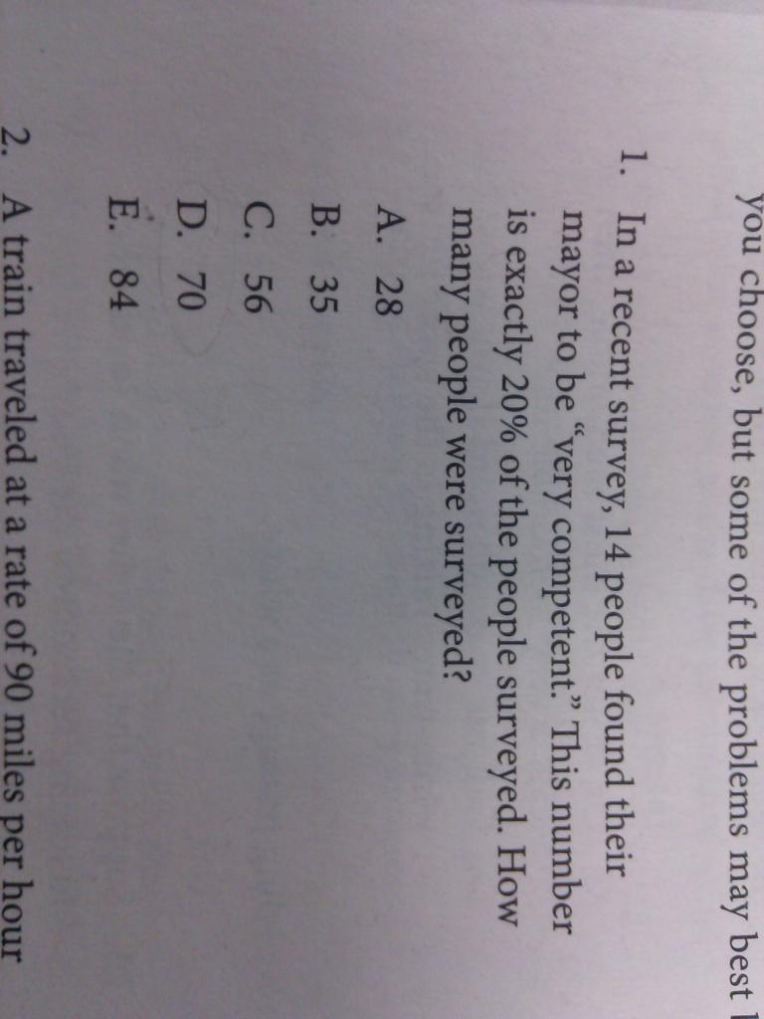

Slide 8
Wednesday
L.T. I can use the DIRT formula to solve a problem

Slide 9
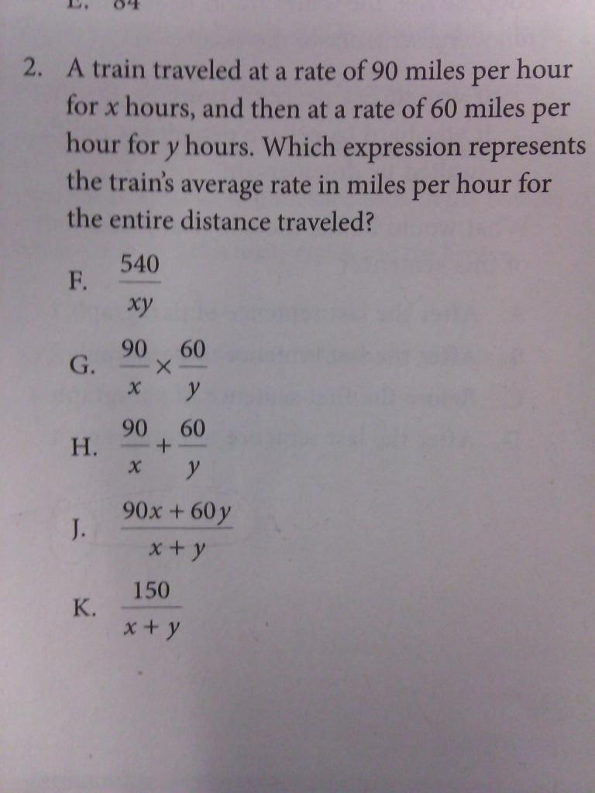

Slide 11
Thursday
L.T. I can effectively edit writing to be precise

Slide 12
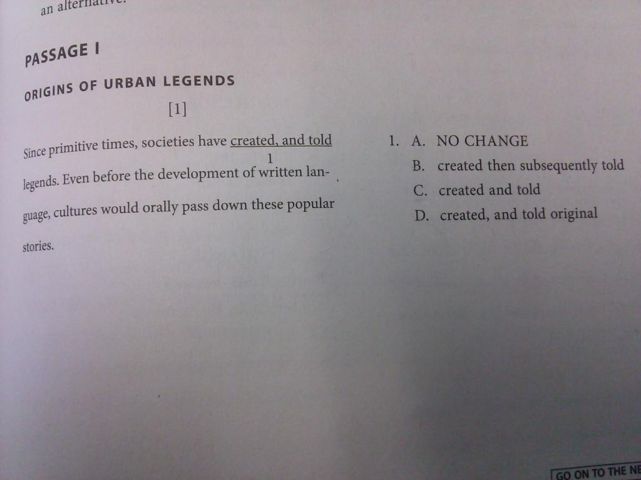

Slide 14
Friday
L.T. I can take notes from a video that mimics a lecture-based college class or business meeting

Slide 15
Ted Talk: Aomawa Shields
How we'll find life on other planets
https://www.ted.com/talks/aomawa_shields_how_we_ll_find_life_on_other_planets#t-33952

Slide 16
Compare & Share
Good note-taking is not finished when the lecture is completed. Take a moment and compare your notes with your seat partner. Add in info that you may have missed in a different color (pencil or pen) to prove that you’ve done this activity!

