Slide 1
Warm Ups
Week 5

Slide 2
Monday
LT: I can use precise language, domain-specific vocab and techniques

Slide 3
Lay vs. Lie Pg 540
Lay: to place or put something down; usually followed by a “something”(direct object/noun or object pronoun)
Ex: Before she begins to paint, Emily lays all of her pencils, brushes, and paints on her worktable to avoid interruptions while she draws and paints.
Lie: to recline, to be in a lying position or at rest; a verb that NEVER takes a direct object! (You NEVER “lie the book on the table”)
Ex: I am not feeling well, so I will go lie down.

Slide 4
Lay vs Lie cont.
The past form of “lie” is identical with the present form of “lay.” This can cause issues in understanding if you are not careful!
Ex: Having laid the picnic cloth under the sycamore, they lay in the shady grass all last Sunday afternoon.

Slide 5
Raise vs Rise Pg 540
Raise: to lift up ; cause to rise or grow; HAS a direct object! (You raise weights, roof beams, tomato plants, or children) & is a VERB
Ex: The trade tariff on imported leather goods raised the prices of Italian shoes.
Rise: to get up, to go up or to be built up; NEVER has a direct object! (You don’t rise anything!)
Ex: Long-distance commuters must rise early and return home late.

Slide 6
Tuesday
LT: I can solve functions

Slide 7
Functions 50 pts
If f(x) = x³ + 6, what is the value of f(3)?
15
33
39
729

Slide 8
Functions 50 pts
If f(x) = x³ + 6, what is the value of f(3)?
15
33
39
729

Slide 9
Reasoning
When asked to find the value of f(a number), just plug in the correct value and simplify!
f(3)= 3³+6
f(3)= 27+6
f(3)= 33

Slide 10
Wednesday
LT: I can utilize my notes and knowledge of commonly confused words to correctly complete the following sentences.

Slide 11
Lie vs Lay *Only write the ANSWER in your notes!
Every afternoon, we _____ on the bed for a nap.
When they’re cold, they ____________ a blanket on their legs.
All of last week I ___________ in bed feeling sick.
Our pet dogs like to _____________ under the table.
While we meet, they __________ their purses on the couch.
Susanna and Maribel often _________ on the floor to make posters.
Last night we all __________ awake until midnight.
Yesterday, our teacher _____ on the ground, injured.

Slide 12
Rise vs. Raise *Only write the ANSWERS in your notes!
I am going to ask my boss to _____ my salary.
When I wanted to answer the question I _________ my hand in class.
I had an early appointment, so I ____________ at 5:00am.
When his alarm goes off, he will _________ and turn it off.
Sam made corrections and his teacher _____________ his grade on the essay.
Because I was so tired, I decided to ______ later than usual.
Jamie watched below as her little sister ______ higher up the mountain.
Johnathan used a block of wood to _______ his bed up higher.

Slide 13
Answers
Lie vs Lay:
lie
lay
lay
lie
lay
lie
lay
lay
Rise vs Raise:
raise
raised
rose
rise
raised
rise
rose
raise

Slide 14
Thursday
LT: I can memorize common conversions to save time and energy
during the SAT and life!

Slide 15
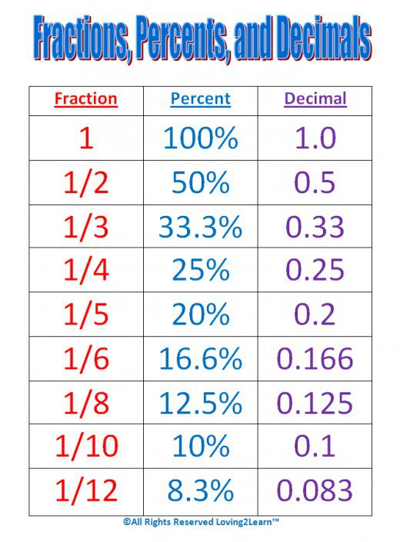
You WILL have a quiz on these next week & will NOT be allowed to use your notes for it.
Take a picture of your notes and review it for a few minutes each day!

Slide 16
Friday
L.T. I can quickwrite about things that are important to me

Slide 17
In your Warm-Up section of your binder:
Write about what your future looks like…
Where are you?
What do you do on a day-to-day basis?
Who are you surrounded by?
What is the weather like throughout the year?
How far away from family are you?
What are your “must haves” to be happy?

