Slide 1
SAT Prep
Week 6 warm-up

Slide 2
Monday
LT: I can use precise language, domain-specific vocab and techniques

Slide 3
Their: POSSESSIVE form of “they”
They’re: Contractions of “they are”
There: Used to introduce a sentence or indicate a location
Ex: The stands were full of students cheering on their team.
Ex: The students say they’re planning to attend college.
Ex: There was plenty of water in the well until the drought caused it to dry up.
Please place your homework over there so I can grade it.

Slide 4
Tuesday
LT: I can use my knowledge of the English language to determine the best revision option

Slide 5
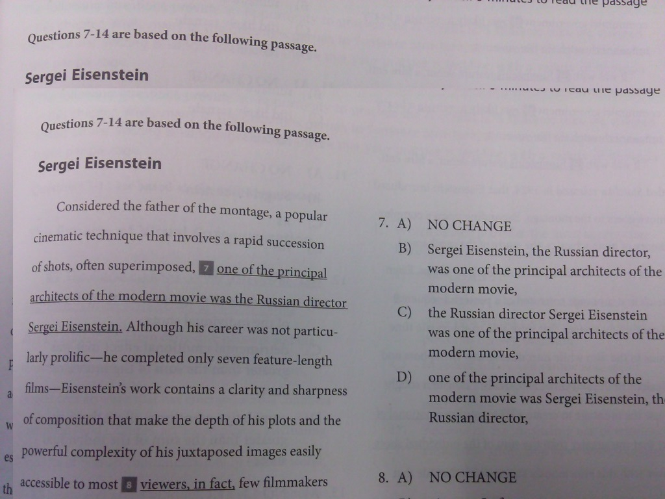

Slide 7
Wednesday
LT: I can use my knowledge of the English language to determine the best revision option

Slide 8
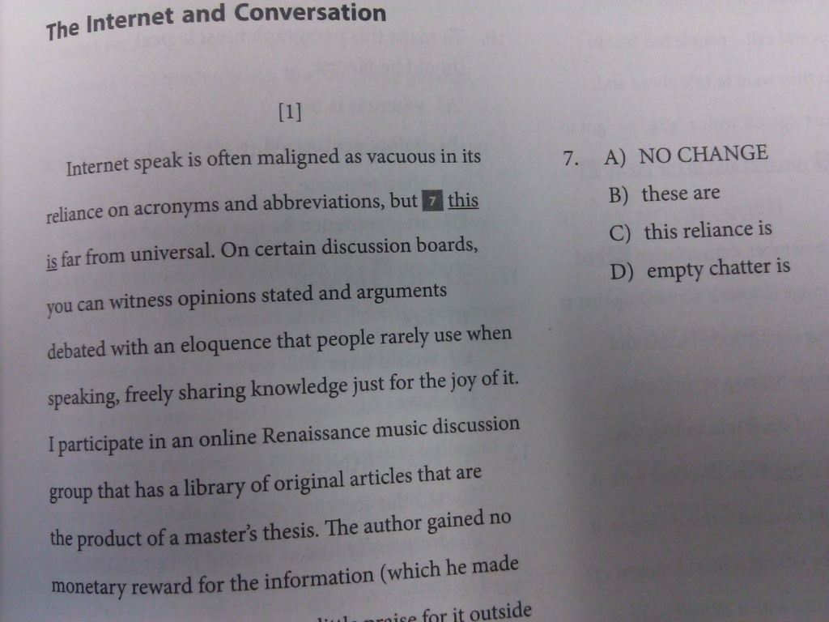

Slide 10
Thursday
LT: I can use the factor labeling method to solve a math problem

Slide 11
Rates, Ratios, % & Proportions 80 pts
A typical song downloaded from the Internet is 4 megabytes in size. Lindy has satellite Internet, and her computer downloads music at a rate of 256 kilobytes per second. If 1 megabyte equals 1,024 kilobytes, about how many songs can Lindy download in 2 hours?
128
450
1, 800
1, 920

Slide 12
Answer & Reasoning
A typical song downloaded from the Internet is 4 megabytes in size. Lindy has satellite Internet, and her computer downloads music at a rate of 256 kilobytes per second. If 1 megabyte equals 1,024 kilobytes, about how many songs can Lindy download in 2 hours?
128
450
1, 800
1, 920
Use Factor-Label method to solve!
256kb/1sec x 60sec/1min x 60min/1hour x 2hours = 1,843,000 kb
1,843,000 kb x 1mb/1,024kb x 1 song/4 mb = 450 songs

Slide 13
Friday
L.T. I can think about my past as a guide for my college essay writing process

Slide 14
Quickwrite
The lessons we take from failure can be fundamental to later success. Recount an incident or time when you experienced failure. How did it affect you, and what did you learn from the experience?

