Slide 1
Trigonometry
10 points

Slide 2
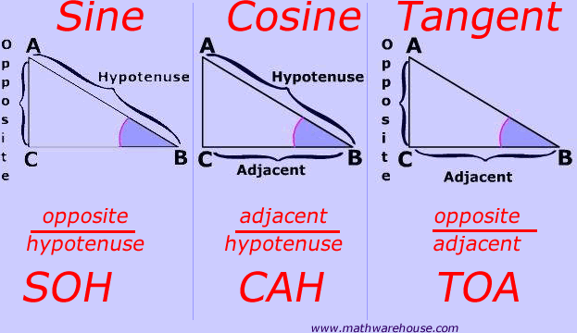
SOH
CAH
TOA

Slide 3
Remember:
Complementary angles = add to 90 degrees
THEREFORE:
sin (x) = cos (90-x)
AND
cos (x) = sin (90-x)

Slide 4
180 degrees =
Radians

Slide 5
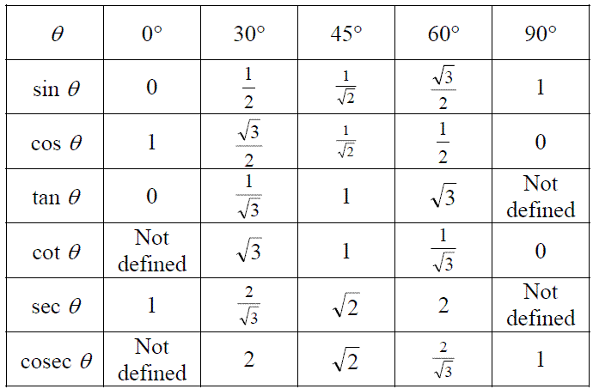
KNOW these!

Slide 6
Have you learned the hand trick for the unit circle? If not, ask your current math teacher about it!

