Slide 1
Systems of Equations
50 points

Slide 2
Solve for 2 variables in 2 equations

Slide 3
To solve a two-variable system of equations, they BOTH must be INDEPENDENT equations

Slide 4
Independent Equations:
equations for which no algebraic manipulations can transform one of the equations into the other
Another way of thinking about it:
the 2 equations create DIFFERENT lines when graphed!

Slide 5
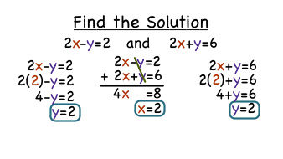
How to SOLVE: 2 options!
Combination (aka elimination by addition):
MOST SAT systems of equations problems are set up to make combination the BEST solving method for speed!
Line up like terms as if adding the equations together and eliminate one variable. This will leave you with 1 equation and 1 variable
Substitution (aka elimination):
Can be applied in EVERY situation BUT can get messy if none of the variables in either equation has a coefficient of 1
Often LONGER (time consuming!)
Solve the simpler of the two equations for one variable, and then substitute the result into the other equation

Slide 7
If your system has... | ...then it will graph as: | Reasoning
NO solution | 2 Parallel Lines | Parallel lines NEVER intersect
1 solution | 2 lines intersecting at 1 point | 2 straight lines have only 1 intersection
Infinitely many solutions | A single line (one line directly on top of another) | 1 equation is a manipulation of the other-- the graphs are the same line

