Slide 1
Similarity, Congruence, & Proofs
Geometry = 40 points

Slide 2
Triangles are SIMILAR
If the angles of 1 triangle are = to the angles of another triangle
OR
If all pairs of corresponding sides of the 2 triangles are in the same proportion
(all sides of the 2nd triangle are 3x as large as the sides of the 1st triangle)

Slide 3
Triangles are CONGRUENT
ONLY IF they have the same angle measurements
AND
the same side lengths

Slide 4
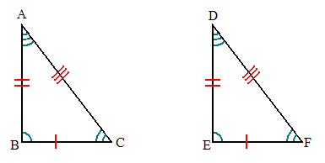
Remember that order matters!
Triangle ABC is congruent to triangle DEF
This is because angles A & D are equal, sides AB & DE are equal, angles B & E are equal, etc.

Slide 6
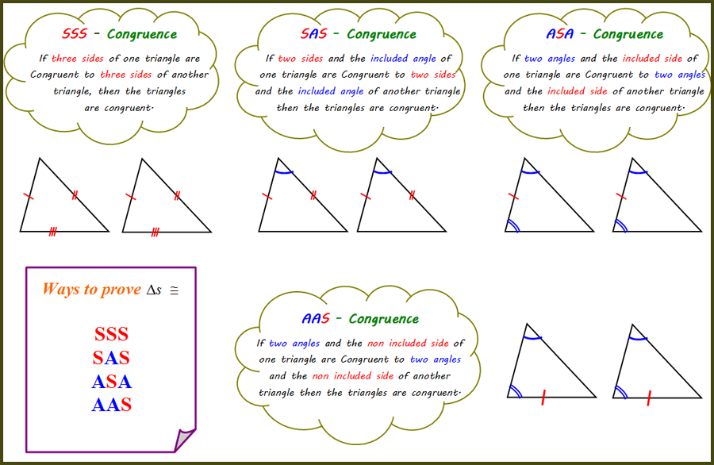

Slide 7
AAA & SSA
DO NOT prove congruency!

