Slide 1
Inequalities
40 points

Slide 2
The equation will have < or >
Instead of = sign

Slide 3
Describe ALL possible values of x
Include ALL solutions for X

Slide 4
If you must multiply or divide by a negative number to solve, you MUST REVERSE the inequality symbol!

Slide 5
-4x < 12
=
Divide both sides by -4
x > -3

Slide 6
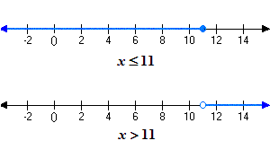
On a number line...
Colored in circle = # is INCLUDED in answer set
Non-colored circle= # is NOT included in answer set

Slide 7
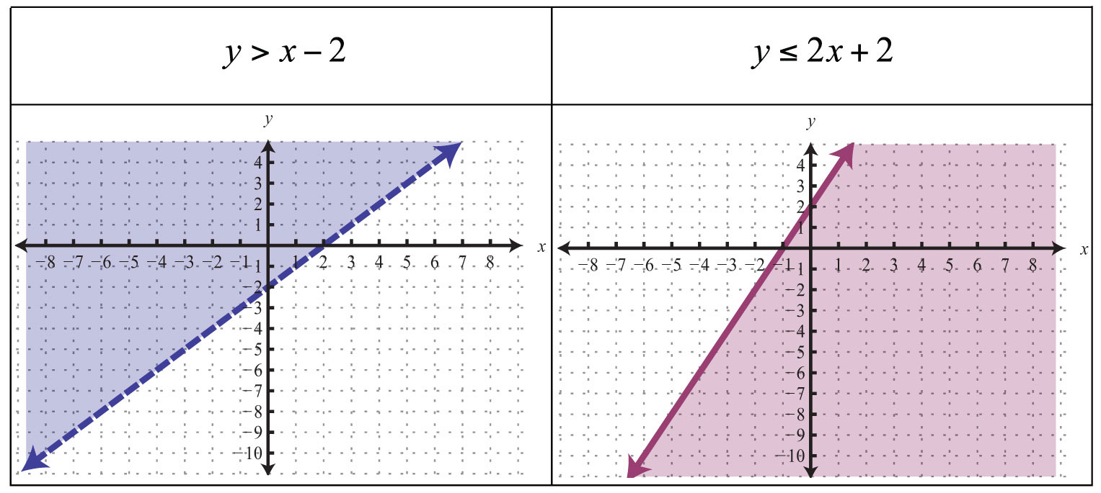
On a graph...
Dashed line = #s are NOT included in answer set
Solid line = #s are INCLUDED in answer set

Slide 8
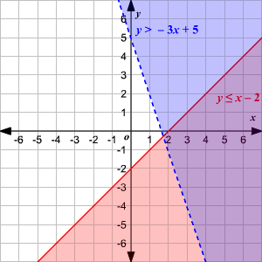
Graphing Multiple Inequalities
The area that overlaps = ALL possible #s in answer set
All of the area that is shaded purple and circled will be included in the answer set of these 2 inequalities!

