Slide 1
Functions
50 points

Slide 2
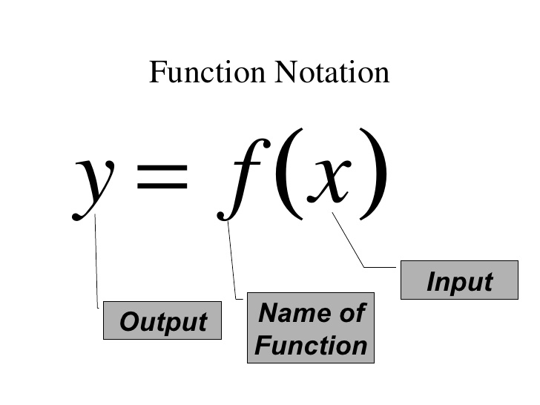
f(3) is read: “f of 3” and it means you substitute 3 into the equation for f

Slide 3
When you are given a graph of a function & asked to find f(3),
Locate 3 on x-axis
Trace up(or down) to the function’s graph
Find the corresponding y-value

Slide 4
When you are given a graph and asked to to find the value of x for which f(x) = 3
Translate this to: “when does the y-value equal 3?”
Find 3 on the y-axis
Trace over to the function’s graph and find the corresponding x-value

Slide 5
When you see... | Convert it to:
(f + g) (x) | f(x) + g(x)
(f - g) (x) | f(x) - g(x)
(fg)(x) | f(x) g(x) {multiply these two together!
(f/g) (x) | f(x) over g(x) {in a fraction!

Slide 6
ALWAYS start with the function closest to the “x” & work your way outward!

Slide 8
When analyzing the graph of a function, the relationship between x & y-values are as follows:
Increasing: y increases as x increases
Decreasing: y decreases as x increases
Constant: y remains the same as x increases (HORIZONTAL line!)

Slide 9
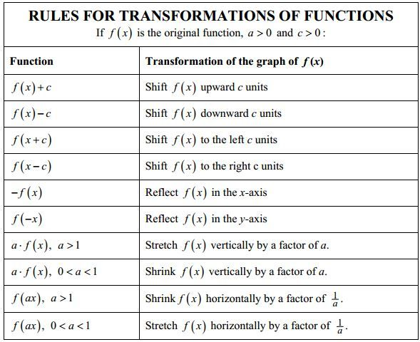
If the transformation is “with the x,” then a HORIZONTAL change occurs (they look OPPOSITE of what they look like)
If the transformation is not “with the x,” a VERTICAL change occurs

