Slide 1
Exponents, Radicals, Polynomials, & Rational Expressions
80 pts

Slide 2
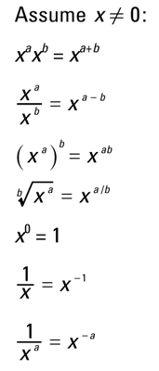
Exponents
Know the rules before test day!
Terms to Know:
Base: The value being multiplied by itself
Exponent: Tells you how many times to multiply!
(pa)^{c} = p^{c} x a^{c}

Slide 3
Let’s try a practice problem...

Slide 4
Radicals
Radicals can be written using fractional exponents. This means that radicals follow the same rules as exponents!
-square roots, cube roots, etc
*KEY: When a fraction contains a radical in the denominator, multiply the numerator AND denominator by the radical in the denominator!

Slide 6
REMEMBER!
Radicals with different indices (square root versus cube root) can only be multiplied and divided!
To do this, you must first write the radical using fractional exponents!

Slide 8
Let’s do another practice problem...

Slide 9
Solving Radical Equations
Isolate the radical part of the equation
Remove the radical using an inverse operation.
For example: to remove a square root, square both sides of the equation; to remove a cube root, cube both sides; so on and so forth!
Solve for the variable.
NOTE: If x² = 81, then x= +/- 9, BUT the square root of 81 can ONLY be 9
Check for extraneous (invalid) solutions

Slide 10
Polynomials
Combine like terms!
Adding & Subtracting: simply combine like terms, paying careful attention to negative signs.
Multiplying: Carefully distribute terms and then combine like terms when possible
FOIL (First, Outer, Inner, Last) when multiplying 2 binomials
An expression or equation with one or more terms consisting of variable with positive integer exponents and coefficients, joined by addition, subtraction, and multiplication

Slide 11
Polynomials cont.
When written in descending order (term with highest power to lowest power):
Tells you a basic shape to its graph and how many x-intercepts (roots/zeros)
Factor the equation and set each factor equal to 0

Slide 12
Let’s try some more practice problems...
Page 202 # 1-20

